Slide 1
Diagnosing performance problems with Lighthouse
Mike Geyser
DevConf 2020

Slide 2
Sorry!

Slide 3

Web Almanac
HTTP Archive's annual state of the web report

Slide 4

JoziJS

Slide 6
Why should we care about performance?
Competitive advantage
‘Just Noticeable Difference’ Research - https://bit.ly/2xEi5yk
Search engine optimization
Speed in Google page ranking - https://bit.ly/2UK9ima
Emerging markets
Building for billions - https://bit.ly/39vYnBY

Slide 7
‘Three Great Virtues of a Programmer’
Laziness
Impatience
Hubris
Larry Wall, Benevolent Dictator for life of the Perl Project, author of ”Programming Perl” and presumeably first of his name? http://threevirtues.com/

Slide 8


Slide 9
What is Lighthouse exactly?
Best practice guidance
Actionable audit responses
Simple aggregated scores
Used by Page Speed Insights
Notes:
Lighthouse is an open-source, automated tool for improving the quality of web pages.

Slide 10
Key metrics
3X
20 %
First Contentful Paint
First Meaningful Paint
First CPU Idle
Time to Interactive
Speed Index
Estimated Input Latency
1X
6.7 %
2X
13.3 %
5X
33.3 %
4X
26.7 %
0X
0.0 %
* These numbers change over time https://web.dev/performance-scoring/

Slide 11
What is FCP?
the time from when the page starts loading to when any part of the page's content is rendered on the screen
user-centric metric for measuring perceived load speed
https://web.dev/fcp/

Slide 12
What is Speed Index?
how quickly content is visually displayed during page load
computes the visual progression between frames
https://web.dev/speed-index/

Slide 13
What is Time-to-Interactive?
the time from when the page starts loading to when its main sub-resources have loaded, and it is capable of reliably responding to user input quickly
helps identify cases where a page looks interactive but actually isn't https://web.dev/tti/

Slide 14
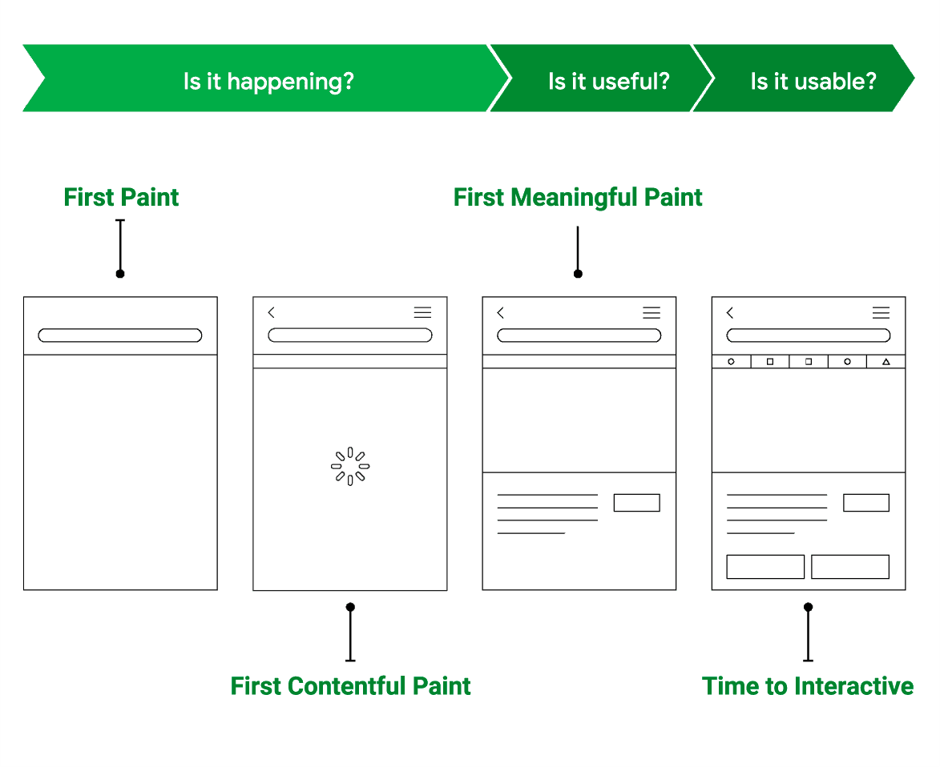
https://web.dev/what-is-speed/

Slide 15
<Demo />

Slide 16
In Conclusion
Understand the key events of your page
Understand your tooling
Cut away from the critical path
Make small, measurable changes
Automate and monitor over time

Slide 17
Questions?
@mikegeyser
mikerambl.es

